Slide 1



Spring IOC
Session
8
Chaim Turkel
Ido Barash

Slide 2


Last session - Maven
What is Maven
Maven architecture
Project structure conventions
Building with Maven
Repository servers (Artifactory)
Continues integration build (Jenkins)

Slide 3
Spring - IOC
Introduction to Spring
Spring core
Inversion Of Control
Bean injection using Spring
Spring IOC annotations
Annotations vs XML

Slide 4

Introduction to Spring
Spring is one of the most popular development framework for enterprise Java applications.
2002 - Rod Johnson decided that EJBs and developing enterprise applications in JAVA are way too complex.
2003 - Introduced: The Spring framework.

Slide 5
Introduction to Spring
Spring is lightweight
Spring is non-invasive.
Promote decoupling and reusability.
Reduce coding
Provide templates to common issues handling.
Easy to use.

Slide 6
Introduction to Spring
Open source project which became a very large umbrella to many sub-projects:
Basically, Spring is here to make our lives as Java developers much easier.
Spring Boot
Spring integration
Spring Data
Spring XD
Spring Mobile
Spring Social
Spring security
Spring Batch
Spring webFlow
Spring LDAP
Spring WS
Spring MVC
Spring Test
Spring Scala
Spring SHELL
Spring Roo

Slide 7




Introduction to Spring
Spring project structure:
Projects Templates
LDAP
XD
Templates
Data
Batch
Security
MVC
Web-Services
Roo
Shell
Social
Mobile
Boot
Web-flow
Test
Integration
Core
IOC container
AOP

Slide 8
Spring core
All Spring projects are based upon the Spring core.
The core has two parts:
IOC container: Instantiate all beans and components. Manage all dependencies and relations between beans.
AOP provider Aspect Oriented Programming engine. Wrap classes and operations with code and perform extra operations, outside of programmed scope.

Slide 9
Inversion Of Control
Instead of object instantiate their dependent objects, These dependent objects are given (or set) by the container.
The container is some sort of a “beans manager”
This is also known as the “Hollywood principle” – Don’t’ call us we call you.
Prevents hard coded object creation.
Prevents hard coupling.
Makes unit-testing very easy.

Slide 10
Inversion Of Control
“Injection” – set a dependent object.
There are two ways to inject a bean to another bean:

Slide 11
Inversion Of Control
“Injection” – set a dependent object.
There are two ways to inject a bean to another bean:
Constructor injection: Pass it as a constructor argument. This is too invasive (demands a constructor)

Slide 12
Inversion Of Control
“Injection” – set a dependent object.
There are two ways to inject a bean to another bean:
Constructor injection: Pass it as a constructor argument. This is too invasive (demands a constructor)
property injection: Using getters and setters to set the properties. Non-invasive at all. Spring uses Reflection API

Slide 13
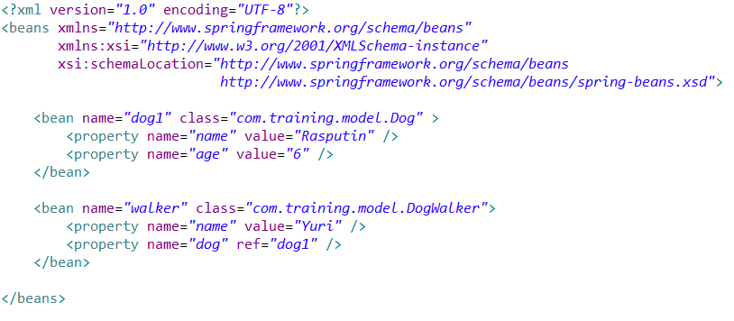
Bean injection
In order to control beans injections, we provide spring with a “mapping” of all relationships.
This mapping is called “Application context” config file.

Slide 14
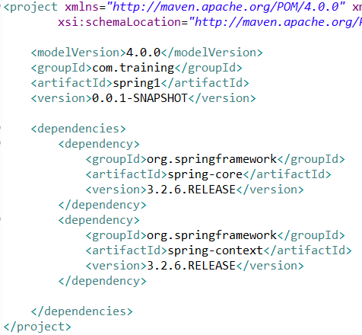
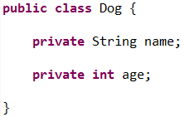
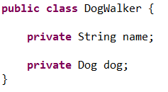
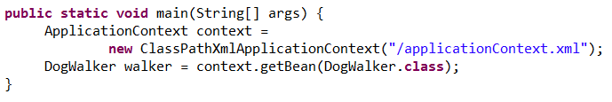
Bean injection

Slide 15
Bean injection
Spring handles bi-directional dependencies just fine.
Spring doesn’t require beans to be defined in the correct order. It will decide the beans creation order on it’s own.

Slide 16
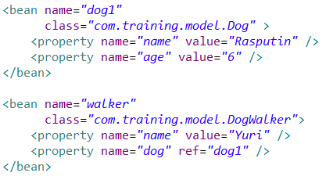
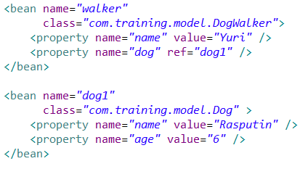
Bean injection
Spring handles bi-directional dependencies just fine.
Spring doesn’t require beans to be defined in the correct order. It will decide the beans creation order on it’s own.

Slide 17
Bean injection
Spring uses a BeanFactory class to instantiate beans.
On program start, Spring scans the context XML file, assembles needed meta-data and uses the factory to create objects.
Beans are created using non-arguments constructors or factory method.
Application context file can become extremely large. Therefore Spring allows us to separate it to several different files.

Slide 18
Exercise
Create a new maven project.
Add spring-core and spring-context as maven dependencies.
Create Class Car(int number, String name)
Create Class Manufacturer (String name, List of cars)
Add toString() for both classes.
Using application context, create three cars and a manufacturer. Add the cars to the manufacturer.
Print

Slide 19
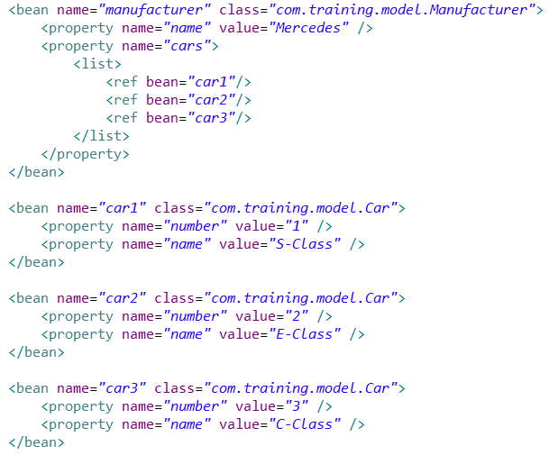
Exercise - solution

Slide 20
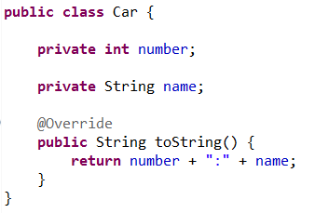
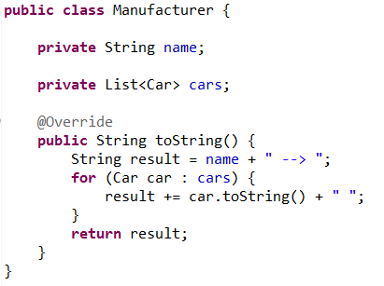
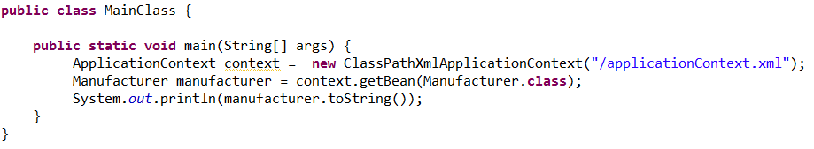
Exercise - solution

Slide 21
IOC annotations
Before Spring 2.5 – XML configuration only
Spring 2.5- XML and annotation based configuration.
Instead of managing big XML files, we can use annotations. Spring will scan our class-path on start-up, look for it’s annotations and use them to instantiate beans.
Spring require annotation support to be activated explicitly:

Slide 22
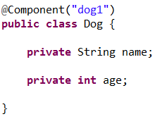
IOC annotations
Annotated class:
Its almost like:

Slide 23
IOC annotations
There are three Spring beans annotations:
@Component: Mark a class as Spring managed.
@Service: Mark a class as Spring managed. State it’s semantic purpose – Service layer.
@Repository: Mark a class as Spring managed. State it’s semantic purpose – DB handler. Wrap DB exceptions with much nicer Spring exceptions.

Slide 24
IOC annotations
Spring finds managed class and searches it’s properties for one of these annotations which does almost the same.
@Autowired: Spring legacy annotation. Part of Spring library.
@Inject: JEE 6 CDI – specification. Require special Jar.
@Resource: Java Standard.

Slide 25
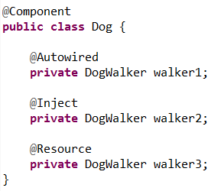
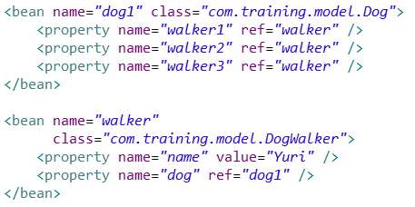
IOC annotations

Slide 26

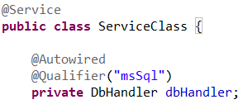

Spring core – IOC annotations
Usually, we inject implementations but work with interfaces.
If there is only one compatible implementation of an injected bean, we can inject it by it’s TYPE.
If there are more implementing classes, we must provide qualifiers or names (@Resouece)

Slide 27
Spring core – IOC annotations
Usually, we inject implementations but work with interfaces.
If there is only one compatible implementation of an injected bean, we can inject it by it’s TYPE.
If there are more implementing classes, we must provide qualifiers or names (@Resouece)

Slide 28
Spring core – IOC annotations
@Autowired and @Inject
Match by TYPE
Restrict by qualifiers
Match by NAME
@Resource:
Match by Name
Match by TYPE
Restrict by qualifiers

Slide 29

Spring core – IOC annotations
Spring managed bean can have different scopes.
Singleton - This bean will be created only once per container. Default scope.
Prototype - Spring will instantiate a new bean each time this bean is requested.
Most beans are usually singletons.
We let Spring enforce singleton pattern - No private constructor and getInstance()

Slide 30
Spring core – IOC annotations
Some times a bean creation process depends on another bean.
For example: a bean query the DB on creation. It must use a DataSource to connect with the DB.
We would like Spring to create the DataSource bean before it’ll create the new bean.
Annotation @DependsOn(“name”) tells Spring to create the bean with the given name before creating the current bean.

Slide 31


Spring core – IOC annotations
Example:
Messages cache loads all the messages texts on creation.
The cache depends on the DataSourcePopulator
Spring will first create the bean with the “dataSourcePopulator” qualifier.

Slide 32
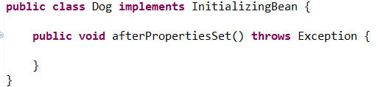
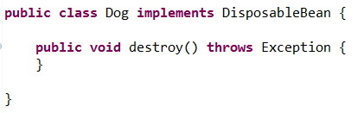
Event handlers
We can interfere with spring beans creation process. And add logics of our own.
Implement InitializingBean interface and it’s method:
Implement DispoableBean interface and it’s method:

Slide 33
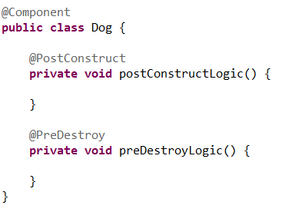
Event handlers
Write a simple method and annotate it with @PostConstruct or @PreDestroy annotaions:

Slide 34
Annotations VS xml
Bean declared in context XML and also has @Component: XML wins over annotation .
XML keeps code much cleaner and allows us to change relations without compiling code.
Annotations are more simple to use and maintain.
Annotations give us some extra semantic functionality like @Service and @Repository.
In XML we can create lists and set contained references easily.

Slide 35

Exercise
Create interface Animal with one method: public String sound()
Create Classes Cat and Dog that implements Animal After creation of eac class print to sysOut: Dog created (or Cat)
Create Class AnimalOwner(Animal animal) Override toString() → “animal sound: …“
Using Spring annotaion, inject dog to the animal owner and print.

Slide 36
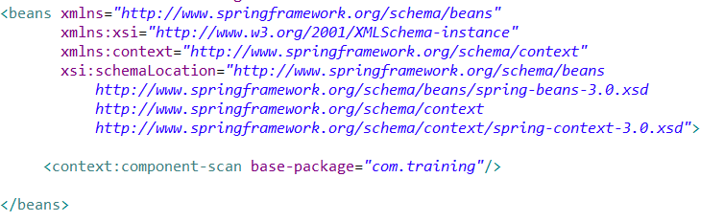
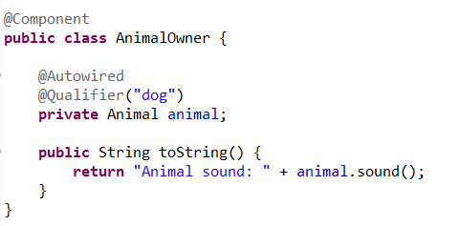
Exercise - solution

Slide 37

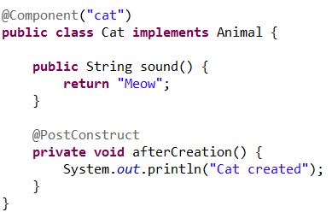
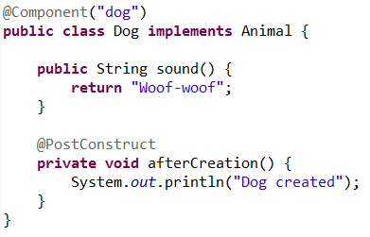
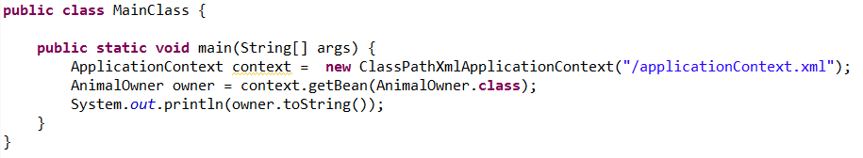
Exercise - solution

Slide 38
Spring - IOC
Introduction to Spring
Spring core
Inversion Of Control
Bean injection using Spring
Spring IOC annotations
Annotations vs XML

Slide 39
Next session – Spring AOP
Spring AOP
Session
9

Slide 40


THANK YOU
Ido Barash
Email: ido.barash@tikalk.com

